Slide 1

Python
Operators AND DATATYPES!
Woooo… fancy! :D

Slide 2

Operators are symbols that help us operate with our variables!

Slide 3
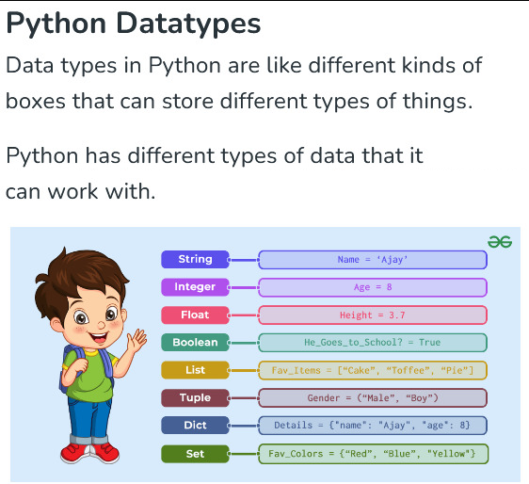
Datatypes

Slide 4
Operations with INTEGERS
6
191498674170295198858523
Let’s learn operations that use integers!
9912
3
123456
0
1029384756

Slide 5
Most common operators are:

Slide 6
Comparison operators
Assignation operator
Arithmetic
operators
=
-
==
/
Operators
*
!=
+

Slide 7
Arithmetic
operators
Think of a calculator, for example! :3
-
/
*
+

Slide 8
Arithmetic
operators
Think of a calculator, for example! :3
-
8 – 2 is 6
/
8 / 2 is 4
*
8 * 2 is 16
+
8 + 2 is 10

Slide 9
BONUS !
An interesting arithmetic operator that super duper advanced programmers use a lot is…

Slide 10
BONUS !
An interesting arithmetic operator that super duper advanced programmers use a lot is…
the modulo operator!

Slide 11
Arithmetic
operators
Think of a calculator, for example! :3
19 % 5 is 4
8 % 2 is 0
9 % 2 is 1
%
This is the modulo operator

Slide 12
Comparison operators
==
!=

Slide 13
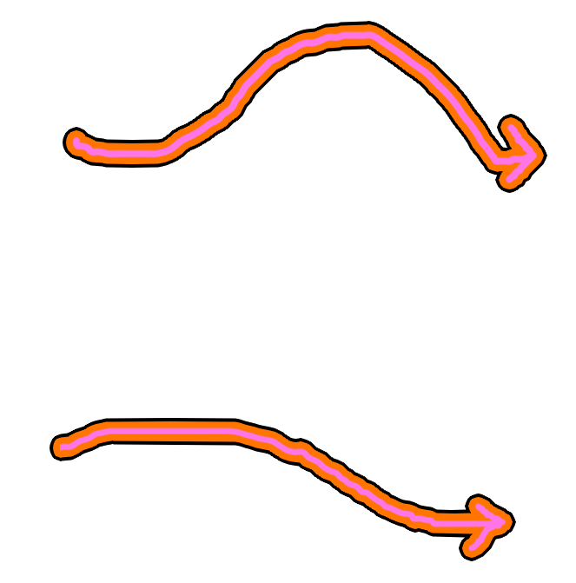
Comparison operators
==
!=

Slide 14
Comparison operators
==
5 != 5 is True
4 != 5 is False
!=
5 != 5 is False
4 != 5 is True

Slide 15
Assignation operator
=

Slide 16
Assignation operator
=

Slide 17
Assignation operator
=
We use this operator to initialize variables… we might see this next class :3

Slide 18


Assignation operator
=
We use this operator to initialize variables… we might see this next class :3

Slide 19
Assignation operator
=
We use this operator to initialize variables… we might see this next class :3
Here, the variable is My_Lucky_Number, its value is 727, and its datatype is int :3

Slide 20
Operations with strings
“Good morning class!”
“This string is so tiny and cute! Don’t you agree? :3”
Let’s learn operations that use strings!
“Hello World”
“This is an awesome string!”
“Argentina is the best country in the world!!!!”

Slide 21
Arithmetic
operators
We can do weird but useful things with strings here!
*
+

Slide 22
Arithmetic
operators
We can do weird but useful things with strings here!
• “hello ” * 4 is “hello hello hello hello”
• “ha” * 10 is “hahahahahahahahahaha”
*
+
• “8” + “3” is 83
• “Grande ” + “Messi” is “Grande Messi”

Slide 23
Comparison operators
==
!=

Slide 24
Comparison operators
==
!=

Slide 25
Comparison operators
==
“Hello” == “Hello” is True
“Hello == “Hi” is False
!=
“Hello” != “Hello” is False
“Hello != “Hi” is True

Slide 26
Assignation operator
=

Slide 27
Assignation operator
=
Again… we use this operator to initialize variables!!! we might see this next class :3

Slide 28

Assignation operator
=
Again… we use this operator to initialize variables!!! we might see this next class :3

Slide 29
Assignation operator
=
Again… we use this operator to initialize variables!!! we might see this next class :3
Here, the variable is My_Favourite_Song, its value is "Beethoven - Symphony No. 9 in D minor, Op. 125", and its datatype is str :3

Slide 30
The result of operations in Python depends on:

Slide 31
The result of operations in Python depends on:
* The operators that we use (*, /, ==, /=, +, %...)

Slide 32
The result of operations in Python depends on:
* The operators that we use (*, /, ==, /=, +, %...)
* The datatypes of the variables that we use (int, float, str, bool…)

Slide 33
The result of operations in Python depends on:
* The operators that we use (*, /, ==, /=, +, %...)
* The datatypes of the variables that we use (int, float, str, bool…)
(💖) Try print("I love " + "learning Python")!

Slide 34
The result of operations in Python depends on:
* The operators that we use (*, /, ==, /=, +, %...)
* The datatypes of the variables that we use (int, float, str, bool…)
(💖) Try print("I love " + "learning Python")!
(✨) Try print("2 + 3")!
(✨) Try print(2 + 3)!

Slide 35

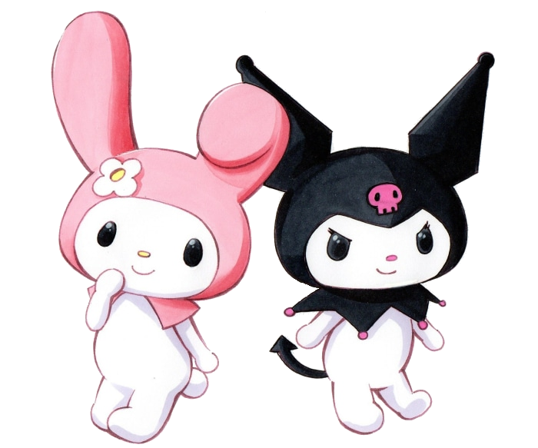


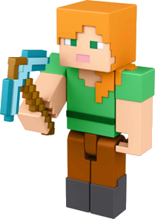
QUIZ TIMEEEEEE

Slide 36
What is an int?
What is a float?
What datatype is True?
What datatype is “False”?
If I write 5 == 2 * 3 in Python, what happens?
If I write 5 == “2 * 3” in Python, what happens? Why?
If I write “python ” * “3” in Python, what happens?
If I write “python ” * “python” in Python, what happens? Why?

Slide 37
What is an int?

Slide 38
What is a float?

Slide 39
What datatype is True?

Slide 40
What datatype is “False”?

Slide 41
If I write print(6 == 2 * 3) in Python,
what happens? Why?

Slide 42
If I write print(6 == “2 * 3”) in Python,
what happens? Why?

Slide 43
If I write print(“6 == 2 * 3”) in Python,
what happens? Why?

Slide 44
If I write “python ” * 3 in Python,
what happens? Why?

Slide 45
If I write “python ” * “python” in Python,
what happens? Why?

Slide 46
Conclusion
Today we learnt about:
Operators: +, -, *, /, =, ==, /=, …
Datatypes: int, float, bool, str, …
See you next time! :)

Slide 47
